Slide 1
Statistical Analysis on Laptop Price Dataset
Professor: Silvia Salini
Presenter: Maedeh Rabiee
Matriculation number:14175A
Major: Data science for economics
September 2024

Slide 2
Introduction
Laptop Specifications vs. Pricing
Analysis Goals: Trends & Clusters
Data Analysis: Visualization & Preprocessing
Machine Learning for Price Prediction & Clustering
Notes:
The goal of this analysis is twofold: first, to identify trends and relationships between laptop specifications and their pricing; and second, to categorize laptops into distinct clusters based on their specifications. By employing clustering techniques such as K-Means and Hierarchical Clustering, we aim to group laptops with similar attributes and uncover meaningful categories, which can help segment the market and identify common characteristics within each group. We will then apply supervised learning algorithms to predict laptop prices and unsupervised learning algorithms, for clustering similar laptops. The performance of these models will be evaluated to ensure the accuracy and relevance of the insights.

Slide 3
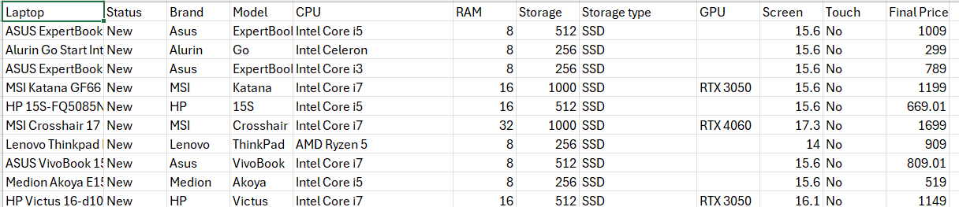
Dataset
https://www.kaggle.com/datasets/juanmerinobermejo/laptops-price-dataset/data
Laptop (character): 2,160 unique laptop descriptions.
Status (character): 2 values (New, Refurbished).
Brand (character): 27 unique brands (e.g., Asus, HP, MSI).
Model (character): 121 unique models.
CPU (character): 28 different processor types (e.g., Intel Core i5, AMD Ryzen 5, Apple M1).
RAM (integer): 9 distinct values (e.g., 4 GB, 8 GB, 16 GB, up to 128 GB).
Storage (integer): 11 unique storage capacities (e.g., 256 GB, 512 GB, 1 TB).
Storage Type (character): 2 values (SSD, eMMC).
GPU (character): 44 unique graphics processors (e.g., RTX 3050, GTX 1650).
Screen (numeric): 30 unique screen sizes (e.g., 15.6", 14", 17.3").
Touch (character): 2 values (Yes, No).
Final Price (numeric): Various unique prices reflect a wide range of laptop prices, from low to high.

Slide 4
Data Preprocessing
Handling missing values
Handling Missing Values in GPU(1371)
Imputing Missing Values in Screen(4)
Imputing Missing Values in Storage.type (42)
Replacing Zero Values in Storage:
Notes:
Therefore, it's essential to impute or handle these missing values appropriately to maintain the integrity of the dataset.
The initial step was to replace any empty strings or cells containing NA values with “NA”, ensuring that missing values were consistently represented.
We checked for missing values in each column, which revealed the following: GPU had the highest number of missing values (1371).
Screen had a few missing values (4).
Storage.type had a moderate number of missing values (42) Handling Missing Values in GPU:
Given that the GPU column is categorical, missing values were replaced with "Unknown" to standardize the dataset and avoid introducing bias by using a more frequent category. Screen :mean
Storage.type mode
Storage :replacing zero with median

Slide 5
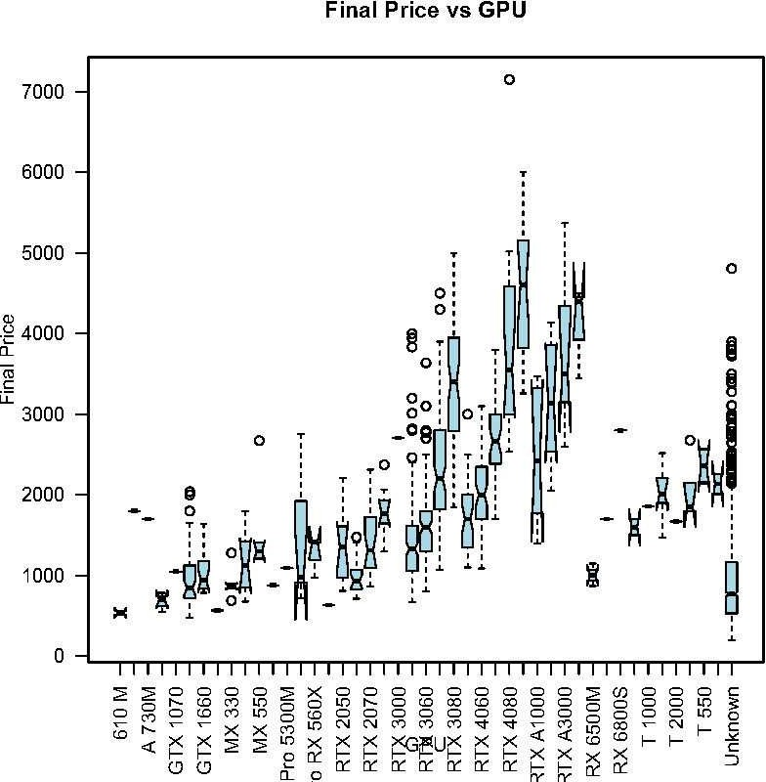
Visualizations
The boxplot compares the distribution of Final Price across different GPU models.
The wide range in the final price for each GPU type suggests a significant variation in the cost associated with different GPU models.

Slide 6
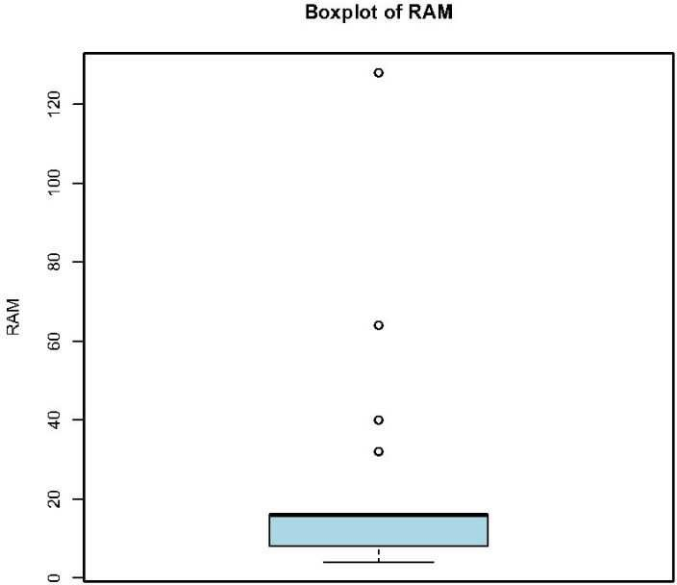
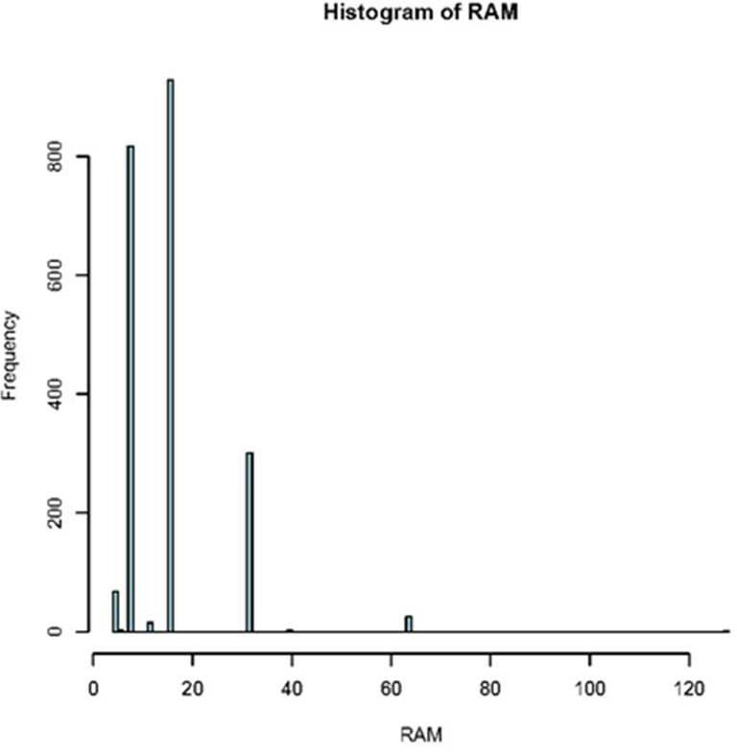
Ram Plots
Notes:
This boxplot shows the distribution of RAM sizes across the laptops in the dataset.
The majority of laptops have RAM sizes clustered around a lower range, with a few outliers extending up
to higher RAM values, including a few above 64 GB.Most laptops have relatively moderate RAM sizes, which are typical for general consumer laptops.
"Number of laptops with RAM greater than 32: 26"
ONLY 1 BIGGER THAN 64 SO REMOVE 1
The histogram displays the frequency distribution of different RAM sizes.
The skewed nature of the distribution suggests that most laptops in the dataset are equipped with mid- range RAM, typical for standard use cases.

Slide 7
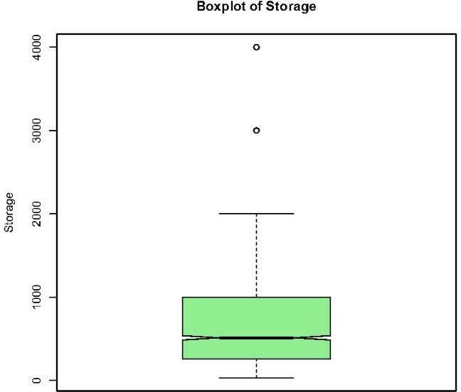
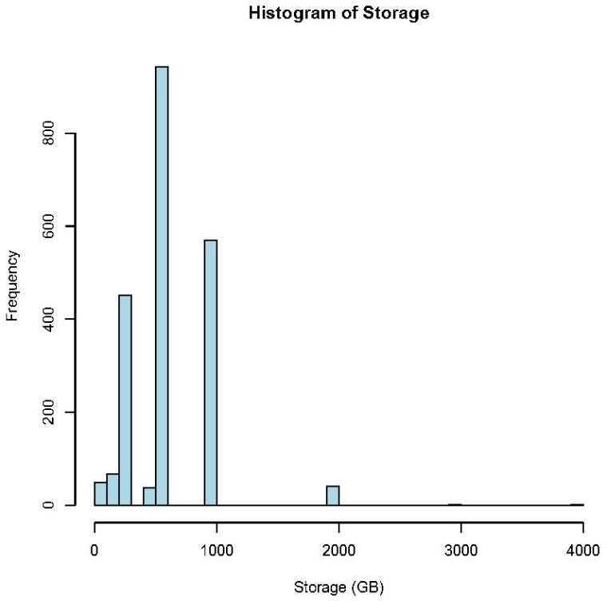
Storage Plots
Notes:
The presence of outliers suggests that some laptops in the dataset have exceptionally high storage capacities,
Similar to the boxplot, the distribution is skewed with most laptops having storage sizes around common capacities such as 256 GB, 512 GB, and 1 TB.
The histogram indicates that very few laptops exceed 2 TB of storage.
There is a sharp decline in frequency as storage capacity increases, indicating that
higher storage laptops are less common and likely more expensive.
print(num_laptops_high_storage) =2

Slide 8
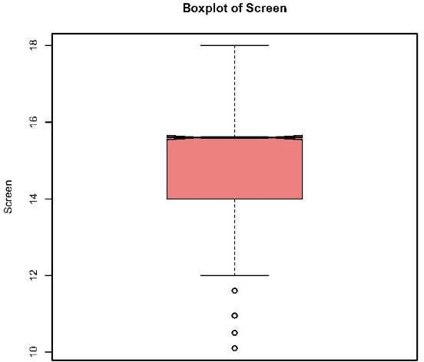
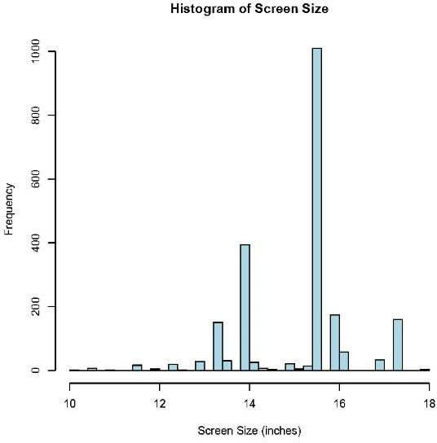
Screen Plots
Notes:
There are a few outliers with smaller or larger screens, likely representing ultra-portable laptops and large gaming or workstation laptops, respectively.
The histogram shows that most laptops have screen sizes clustered around 15 to 16 inches. There is a clear peak at 15.6 inches, which is a common screen size for mainstream laptops.
Smaller screens around 13-14 inches and larger screens around 17-18 inches are less frequent, indicating that they cater to more niche markets (e.g., ultra-portables and gaming laptops).
num_laptops_small_screen <- sum(data$Screen < 12) > # Print the result > print(num_laptops_small_screen) [1] 25

Slide 9
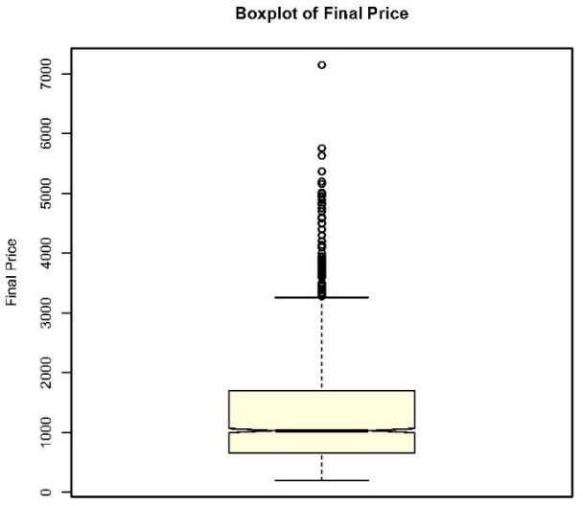
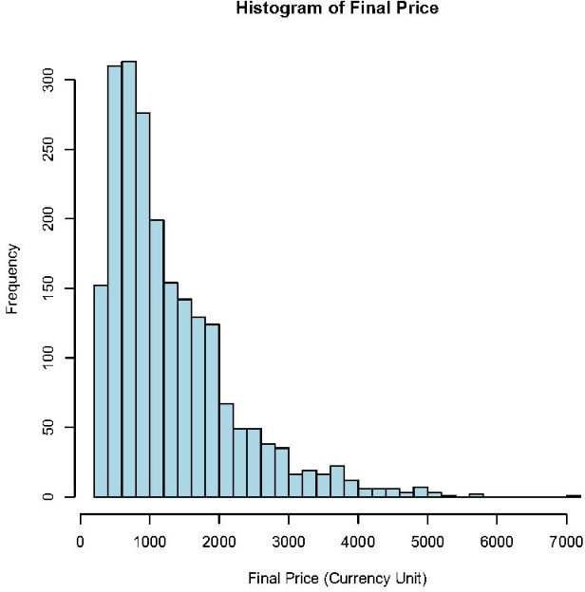
Final Price Plots
Notes:
There are many outliers on the higher end, indicating a significant number of laptops that are priced well above the median, likely due to premium features or high-performance components.
The histogram shows that the distribution of laptop prices is heavily skewed towards the lower end, with a large number of laptops priced between 500 and 1500 currency units.
There is a long tail extending towards the higher prices, reflecting the high-end laptops that are priced significantly higher than the average.

Slide 10
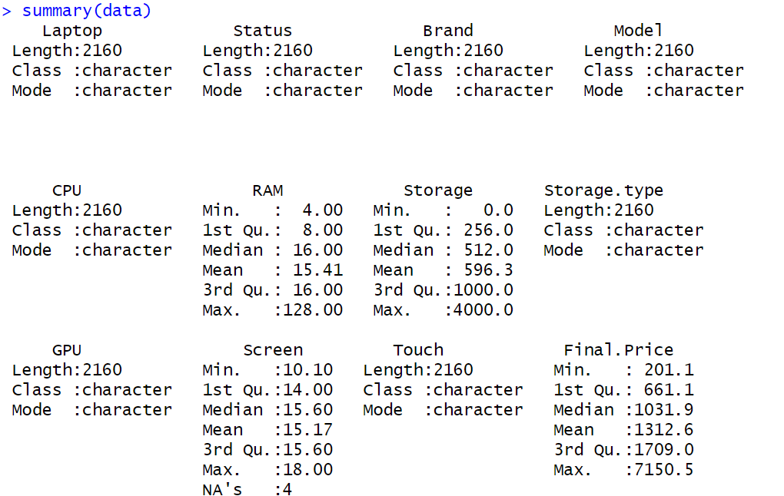
operation on Numerical data
Handling Outliers:
Removing Laptops with More Than 64 GB of RAM
Removing Laptops with Storage Greater Than 2000 GB
Capping the Final Prices at 5000 Units
Notes:
remove extreme values and refine the data for better analysis. The process involved removing outliers based on our knowledge of typical laptop specifications available in today's market, rather than strictly adhering to statistical definitions of outliers, such as those indicated by Box PlotS are rare in most consumer markets today

Slide 11
Skewness Transformation
Original Skewness Values
RAM: 2.03
Storage: 1.32
Screen: -0.58
Final Price: 1.52
Skewness After Transformation
RAM: 0.39
Storage: 0.31
Screen: -0.50
Final Price: 0.10
scaling
Notes:
We analyzed the skewness of four key numerical variables: RAM, Storage, Screen, and Final Price. The goal was to reduce skewness and improve data distribution for better model performance. Skewness indicates the asymmetry of data, and highly skewed variables can negatively affect machine learning models. RAM&Final Price : A log transformation (log(RAM + 1)) was applied to reduce the positive skewness
Screen: A reverse log transformation (log(max(Screen + 1) - Screen)) was applied
Storage: A square root transformation (sqrt(Storage)) was applied, which is often useful for
reducing positive skewness in variables with wide-ranging values. Scaling involves standardizing each variable to have a mean of 0 and a standard deviation of 1 Why Scaling is Important?
Numerical features RAM, Storage, Screen size, and Final Price originally have different ranges. For example, RAM might range from 4 to 64 GB, while Storage could range from 128 to 4000 GB. Without scaling, models that are sensitive to the magnitude of numerical values (like K-Means clustering, SVMs, or linear regression) might assign disproportionate importance to features with larger ranges, skewing results

Slide 12
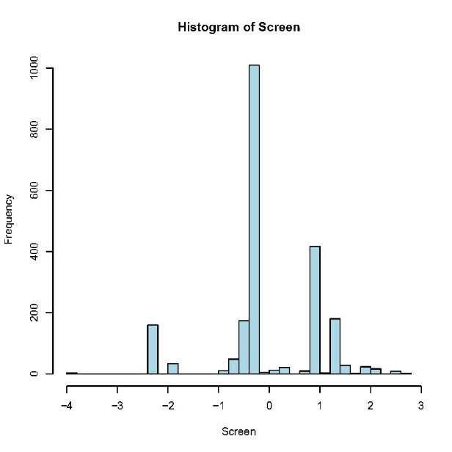
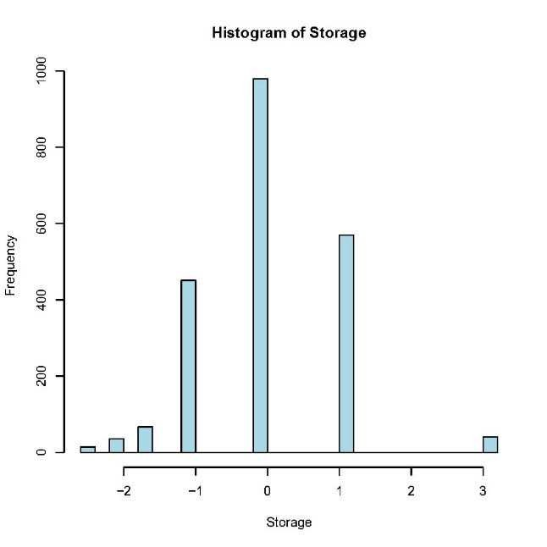
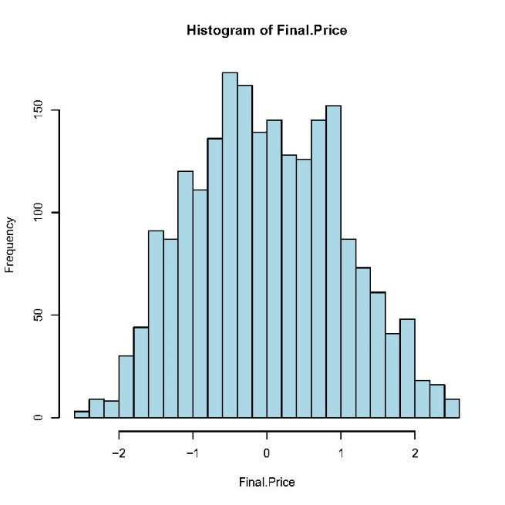
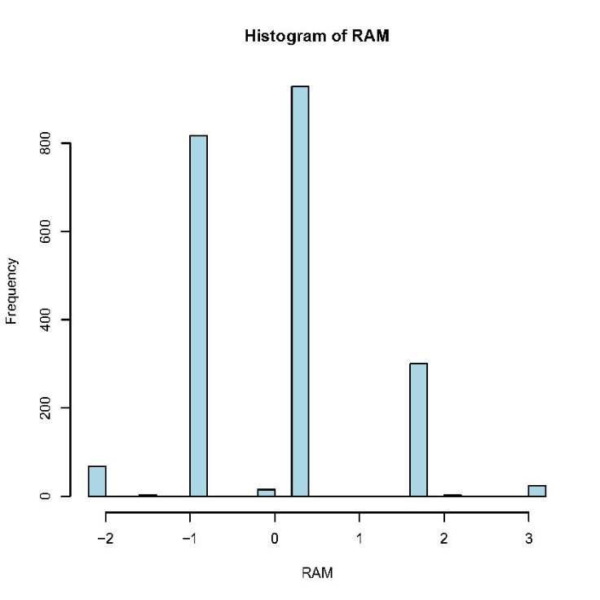
Checking Normality
histogram of numerical after scaling:
Notes:
Now you can see that now the graphs are much more similar to the normal distribution graph

Slide 13
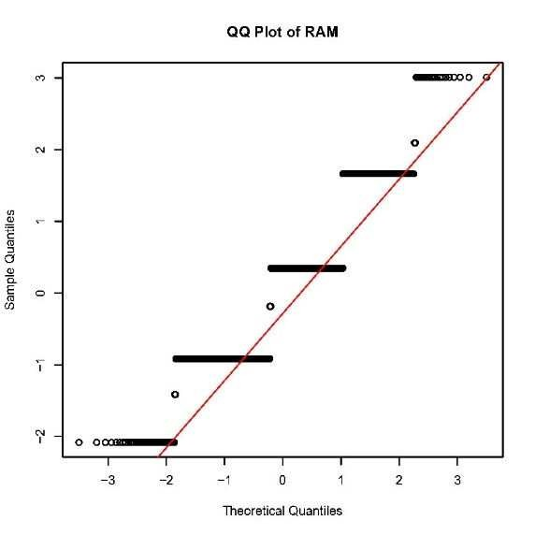
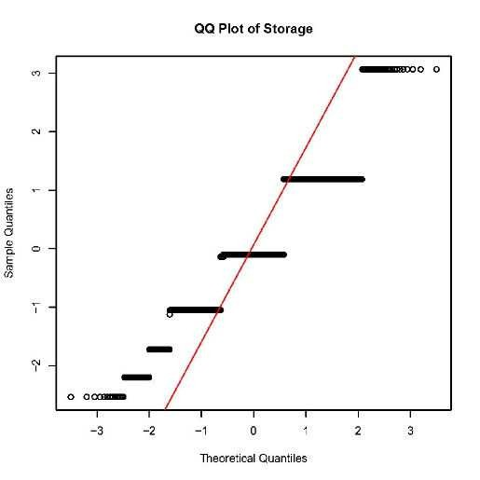
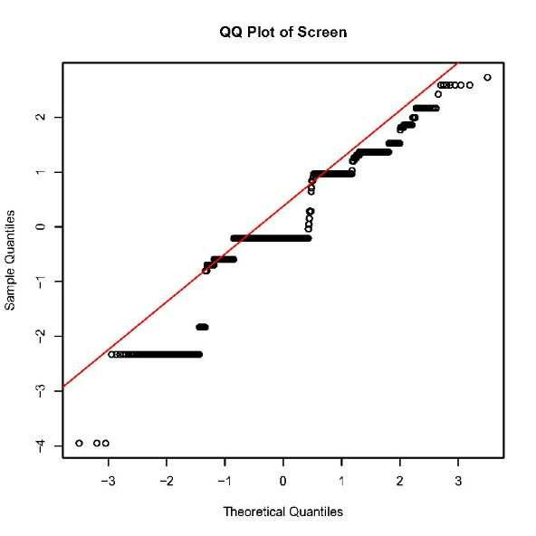
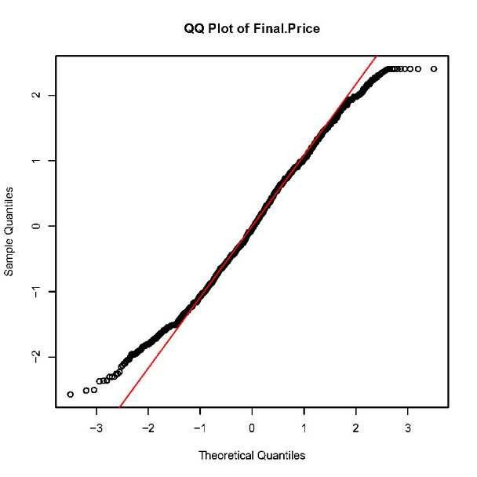
QQ Plots of numerical (RAM, Storage, Screen, Final Price)
Notes:
Screen Size: The QQ plot for screen size suggests non-normality, with significant deviations from the line, especially at the lower and upper ends.
Final Price: The QQ plot for final price shows some deviation from normality but less pro
nounced than the other variables. The data is moderately skewed
QQ plots help assess the normality of the distributions by comparing the quantiles of the data with the theoretical quantiles from a normal distribution.

Slide 14
Shapiro-Wilk Test
it is used to test the null hypothesis that the data is normally distributed.
RAM: W = 0.856, p-value = 1.505e-40. The p-value is extremely low, rejecting the null hypothesis and indicating that the RAM data is not normally distributed.
Storage: W = 0.882, p-value = 9.991e-38. Similar to RAM, the low p-value indicates non-normality.
Screen: W = 0.872, p-value = 7.766e-39. The screen size data is also not normally distributed.
Final Price: W = 0.991, p-value = 6.224e-10. Although the p-value is low, the deviation from normality in the final price is less pronounced than in the other variables.

Slide 15
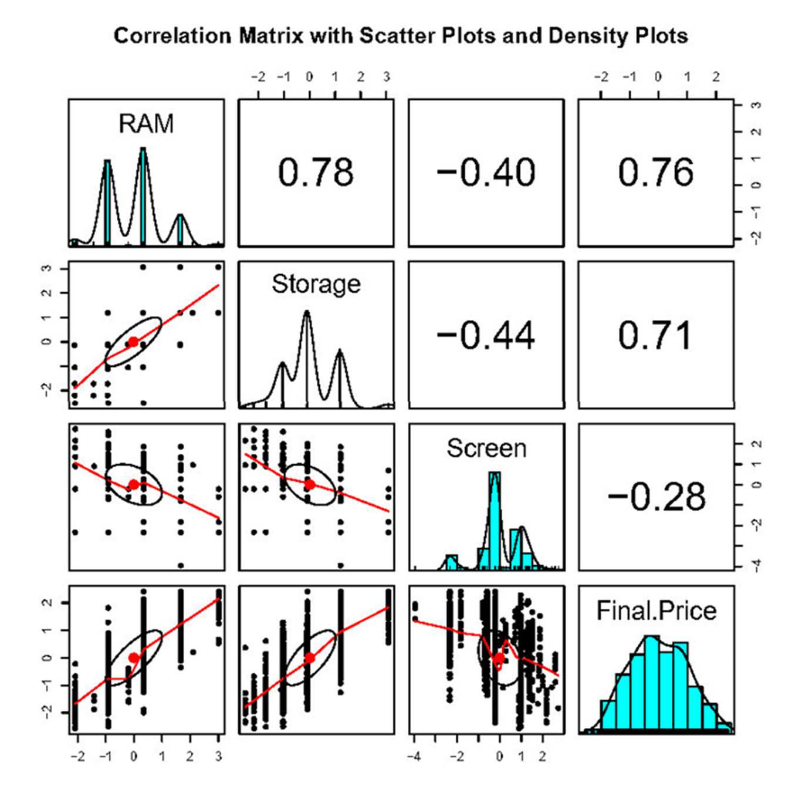
Interpretation of the Correlation Matrix
Correlation Matrix:
RAM and Final.Price (0.76)
RAM and Storage (0.78)
Storage and Final.Price (0.71)
Screen and Final.Price (-0.28)
Screen and RAM (-0.40)
Screen and Storage (-0.44)
Notes:
RAM and Storage (0.78):
o Interpretation: There is a strong positive correlation between RAM and Storage. Laptops
with more RAM tend to also have more storage capacity, which makes sense as higherend laptops often come with both larger RAM and storage. Screen and Final.Price (-0.28):
o Interpretation: The correlation between Screen size and Final.Price is negative but weak.
This means that larger screens are slightly associated with lower prices, but the
relationship is not strong. Interpretation: There is a strong positive correlation between RAM and Final.Price,
indicating that as the amount of RAM in a laptop increases, the final price tends to increase
as well

Slide 16
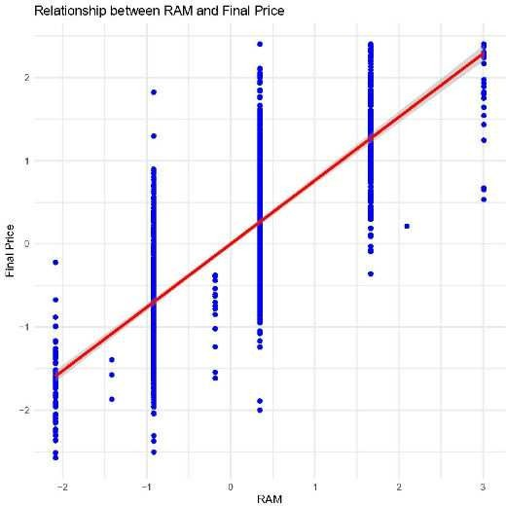
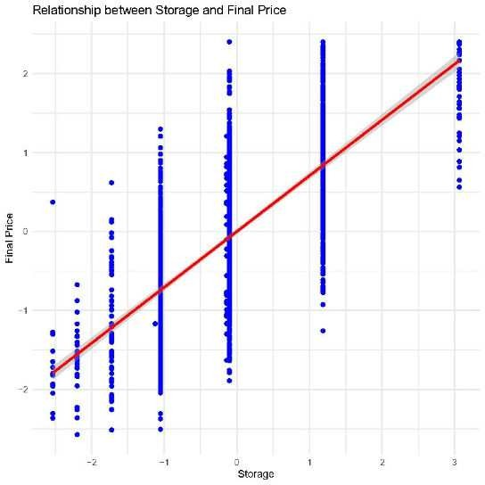
Scatter Plots of Numerical Variables Against Final Price)
Storage vs Final.Price
RAM vs Final.Price
Notes:
RAM vs Final.Price
The scatter plot with a linear regression line shows a positive relationship between RAM and Final.Price. As RAM increases, the Final.Price tends to increase as well, which makes sense as more RAM typically corresponds to higher-performance laptops that are priced higher.
Storage vs Final.Price:
Similar to RAM, there is a positive relationship between Storage and Final.Price.
Laptops with larger storage capacities are generally more expensive, reflecting the additional cost of more or higher-quality storage hardware.

Slide 17
VIF (Variance Inflation Factor)
What is VIF?
Variance Inflation Factor (VIF)
Interpretation of VIF Values:
RAM (2.59)
Storage (2.70)
Screen (1.25)
Notes:
Variance Inflation Factor (VIF) measures how much the variance of a regression coefficient is
inflated due to multicollinearity among the predictors. Multicollinearity occurs when predictors
are highly correlated with each other, which can make it difficult to estimate the relationship
between each predictor and the outcome variable independently Between 1 and 5: Indicates moderate multicollinearity.Above 5 or 10: Suggests high multicollinearity, and you may need to consider removing or combining variables.

Slide 18
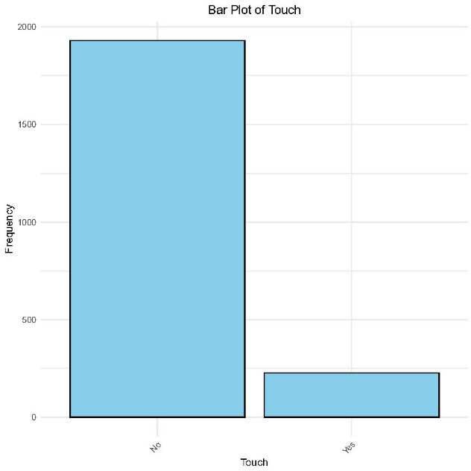
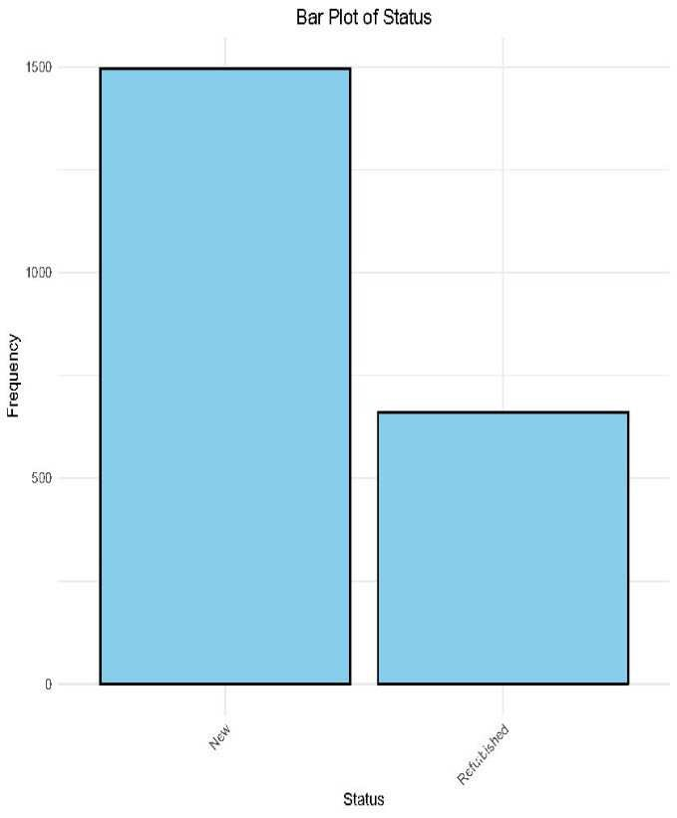
Operations on Categorical data
Visualization
Notes:
Status:
The bar plot shows that most laptops in the dataset are New, with a smaller proportion being Refurbished. This indicates a dataset with a majority of new laptops, which is typical in many electronics datasets where new items dominate.
Brand:
The bar plot for Brand reveals that certain brands like Asus, Dell, and HP are more frequent in the dataset. The distribution suggests that the dataset is skewed towards these popular brands, which may dominate the market share The plot reveals that most laptops in the dataset use SSD (Solid State Drive) storage, with a few using eMMC.
This trend reflects the modern preference for SSDs, which are faster and more reliable than older storage technologies

Slide 19
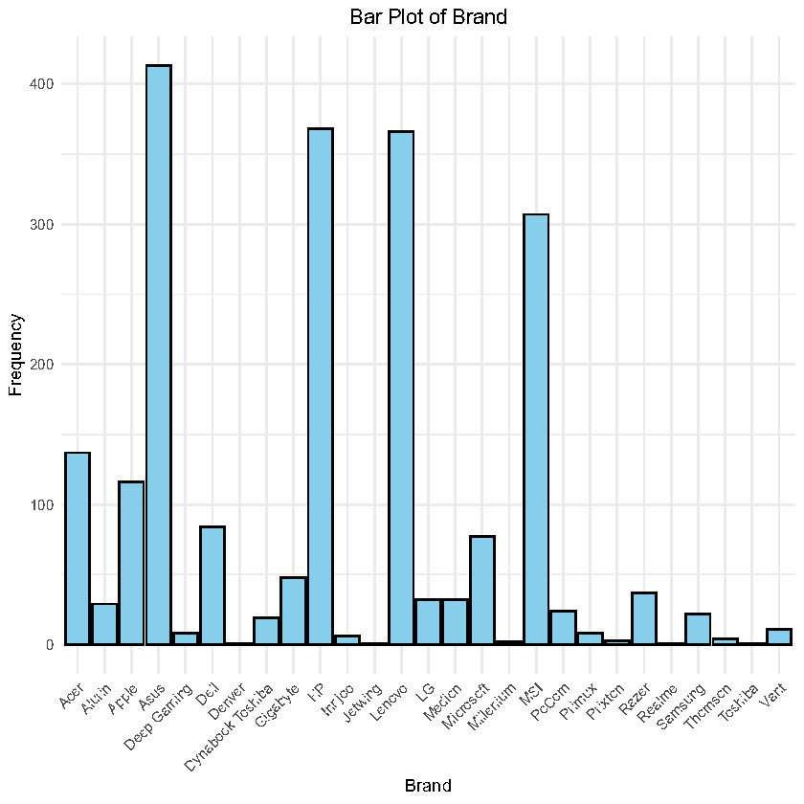
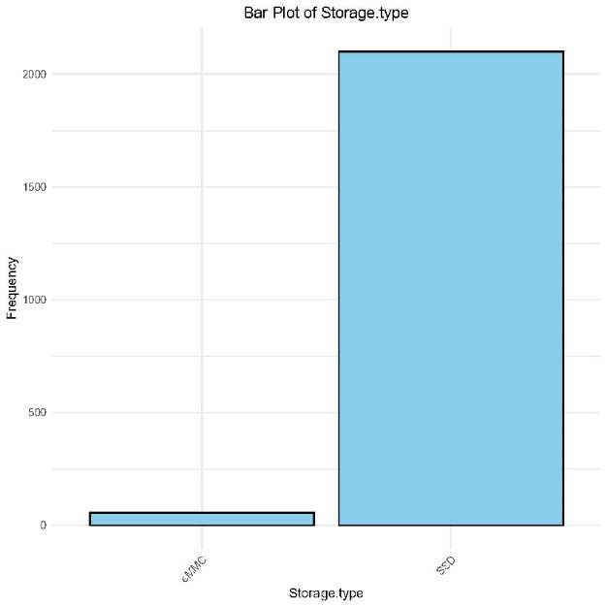
Plots of Categorical Variables
Brand:
The bar plot for Brand reveals that certain brands like Asus, Dell, and HP are more frequent in the dataset. The distribution suggests that the dataset is skewed towards these popular brands, which may dominate the market share.
Storage. Type:
The plot reveals that most laptops in the dataset use SSD (Solid State Drive) storage, with a few using eMMC.

Slide 20
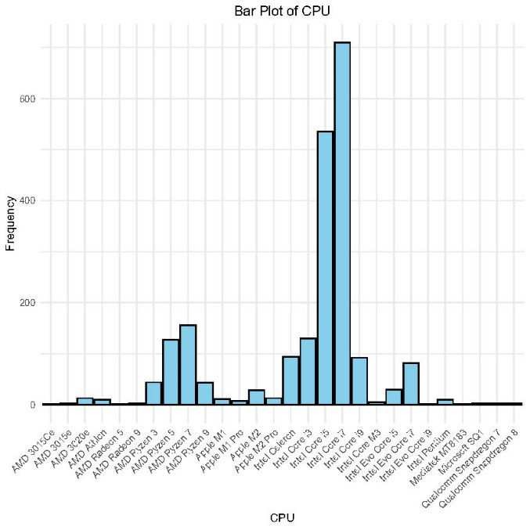
CPU Plot
The bar plot for CPU shows a concentration around a few popular processors, particularly those from Intel. This reflects the dominance of certain CPUs in the market, such as the Intel Core i5 and i7 series.

Slide 21
Encoding of Categorical Variables
In this preprocessing step, we transformed categorical variables into numerical form to prepare the dataset for machine learning models. Below are the steps undertaken:
Categorical Variable Encoding
Touch: Encoded as binary (1 for "Yes", 0 for "No").
Status: Encoded as binary (0 for "New", 1 for "Refurbished").
Storage Type: Encoded as binary (1 for "SSD", 0 for "eMMC").
Brand, Model, CPU, GPU: These categorical variables were converted into numeric values based on their factor levels.
Notes:
data$Brand <- as.factor(data$Brand)
data$Brand_encoded <- as.numeric(data$Brand)

Slide 22
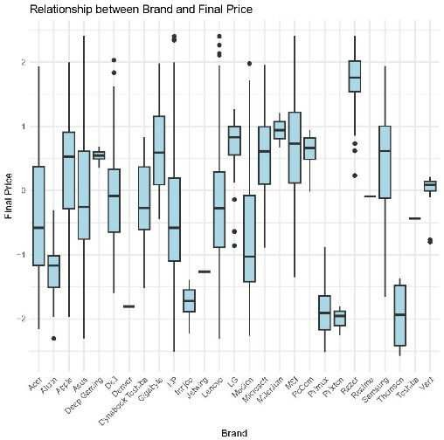
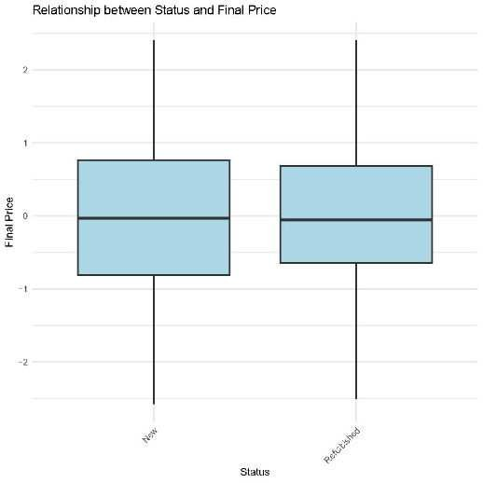
Relationship between categorical features and target variable
Relationship between status and Final Price
Relationship between Brand and Final Price
Notes:
New laptops have a slightly higher median price than Refurbished ones,

Slide 23
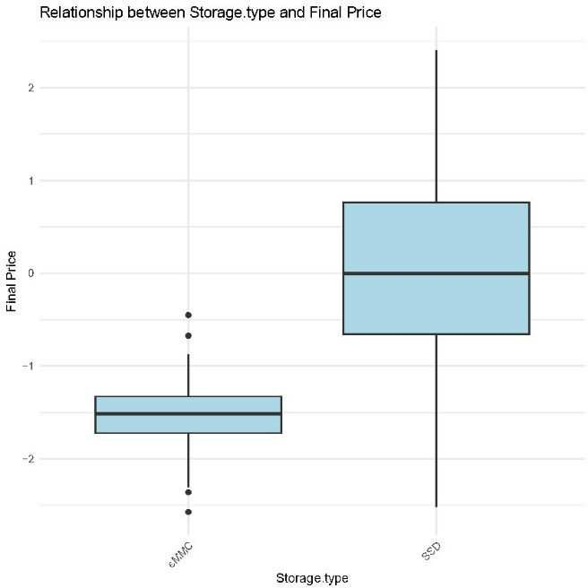
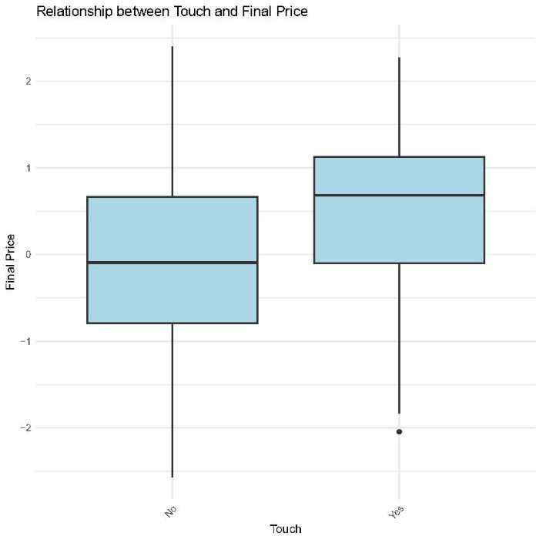
Relationship between categorical features and target variable
Relationship between Storage Type and Final Price:
Relationship between Touch and Final Price

Slide 24
Feature Selection
The following features were selected for model training:
RAM, Storage, Screen: Original numerical features.
Touch_encoded, Status_encoded, Storage.type_encoded: Encoded categorical variables.
Brand_encoded, Model_encoded, CPU_encoded, GPU_encoded: Encoded brand, model, CPU, and GPU.
The target variable is Final Price,
Notes:
Considering that in the real world all these features affect the price of the laptop, we decided that all the variables

Slide 25
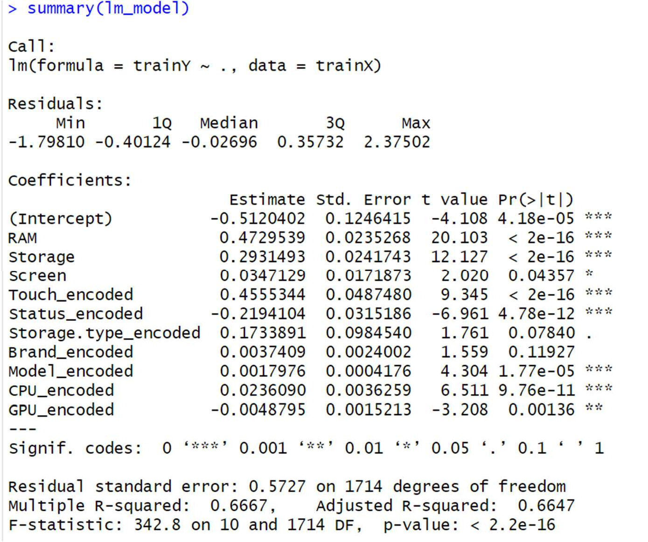
Supervised machine learning methods
Linear Regression Model
Brief Conclusion:
The model explains about 67% of the variance in the target variable (Final.Price).
RAM, Storage, Touchscreen feature, and CPU have a strong positive impact on the target, while
Status and GPU have significant negative effects.
Overall, the model is statistically significant with a good fit
Notes:
Residuals:
o The residuals indicate the difference between observed and predicted values. The median
is close to zero, which is a good sign, but the residuals range from -1.79810 to 2.37502,
showing some variability in prediction accuracy.
2. Coefficients:
o Each coefficient represents the effect of one unit change in the predictor (independent
variable) on the target variable (final price), while holding other variables constant.
o Significant variables (marked with ***, **, or *) have a low p-value (< 0.05), meaning
they have a statistically significant impact on the target variable: F-statistic: 342.8, with a very small p-value (< 2.2e-16), suggesting that the model as a
whole is statistically significant.

Slide 26
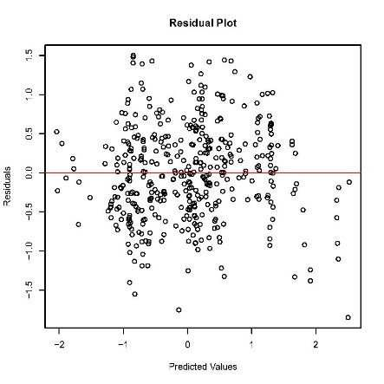
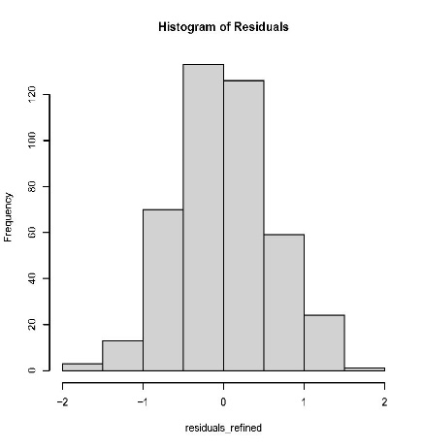
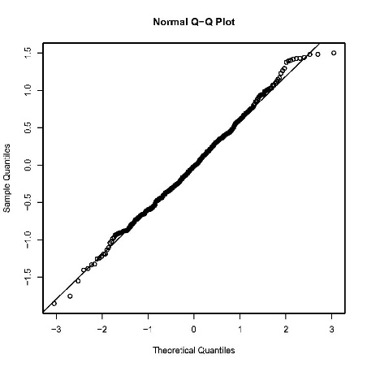
Plots Interpretation
Notes:
Actual vs Predicted Plot: This plot shows how well the predicted prices match the actual prices. The points are scattered around the diagonal line, indicating a good fit. Some deviations are expected, but overall the model seems to perform well.
Histogram of Residuals: The residuals appear to be roughly normally distributed, which is a good sign that the model's assumptions are valid.
Normal Q-Q Plot: The Q-Q plot shows that the residuals follow a straight line, which indicates that they are normally distributed—a key assumption of linear regression.

Slide 27
Interpretation of the Results
A) Shapiro-Wilk normality test
p-value = 0.001791: This is the key value for interpretation. A p-value < 0.05 indicates that the residuals do not follow a normal distribution
Durbin-Watson Test:
DW = 2.0327, p-value = 0.751
p-value = 0.751:
Summary:
Shapiro-Wilk Normality Test: the residuals do not follow a normal distribution.
Durbin-Watson Test: there is no evidence of autocorrelation in the residuals of the regression model.
Therefore, more robust methods should be employed, as the assumptions of linear regression are not fully met .
Notes:
The p-value of 0.751 is much greater than 0.05, meaning we fail to reject the null hypothesis.
The null hypothesis in the Durbin-Watson test is that no autocorrelation is present in the
residuals.

Slide 28
Support Vector Machine
In this model, we used the RBF kernel to handle non-linear data and epsilon regression for continuous output.
R-squared: 0.80
Explanation: The SVM model with a radial kernel provides an R-squared value of 0.80. This means that the model explains about 80% of the variance in the Final. Price. SVM is particularly effective for non-linear relationships, and the relatively high R-squared value indicates that the model fits the data well, capturing a substantial portion of the variability in Final. Price.
Notes:
The core idea of SVM is to find a hyperplane (or decision boundary) that best separates data points from different classes in the feature space.
In this model, we used the RBF kernel to handle non-linear data and epsilon regression for continuous output

Slide 29
Random Forest Model
R-squared: 0.88
Explanation: This method, achieves the highest R-squared value of 0.88. This implies that 88% of the variance in Final.Price is explained by the model. The high R-squared value indicates that the Random Forest model is highly effective at capturing the underlying patterns in the data. It combines the predictions of multiple decision trees to improve accuracy and robustness, leading to a strong predictive performance.
Notes:
Random forest regression is a supervised learning algorithm and a type of bagging technique that employs ensemble learning for regression tasks in machine learning. In this approach, multiple decision trees are built independently and in parallel, with no interaction between the trees during their construction. During training, a large number of decision trees are created, and the final output is determined by either the mode of the predictions for classification tasks or the average of the predictions for regression tasks. This approach helps to overcome the limitations of individual decision trees, such as overfitting and high variance.

Slide 30
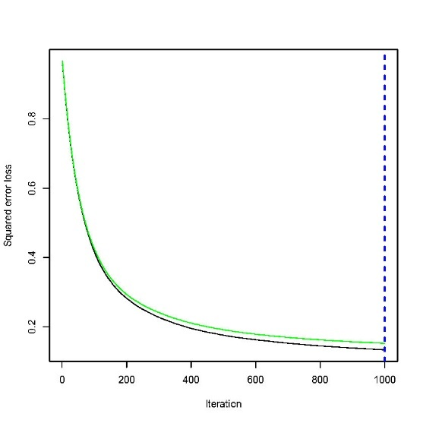
Gradient Boosting Model
Explanation: We used cross-validation to find the optimal number of iterations (best_iter)which is1000 based on the picture. Then we used this optimal number for the number of trees when making predictions. This prevents using too many trees and overfitting the model.
The Gradient Boosting model yields an R-squared value of 0.87, indicating that 87% of the variance in Final. Price is explained by the model.
Notes:
Gradient Boosting is a powerful machine-learning algorithm used for both classification and regression tasks. It builds models sequentially, where each new model corrects the errors of the previous one. Unlike Random Forest, where trees are built independently, Gradient Boosting builds one tree at a time, focusing on reducing the errors from the previous models

Slide 31
Conclusion
The models' R-squared values indicate the following ranking in terms of performance:
Random Forest (0.88): Best performance, capturing the majority of the variability in Final.Price.
Gradient Boosting (0.87): Close second, with strong predictive capabilities.
Support Vector Machine (0.80): Good performance, especially in capturing non-linear relationships.
Linear Regression (0.69): Moderate performance, capturing linear relationships.

Slide 32
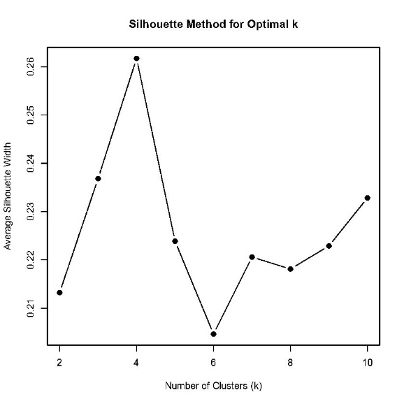
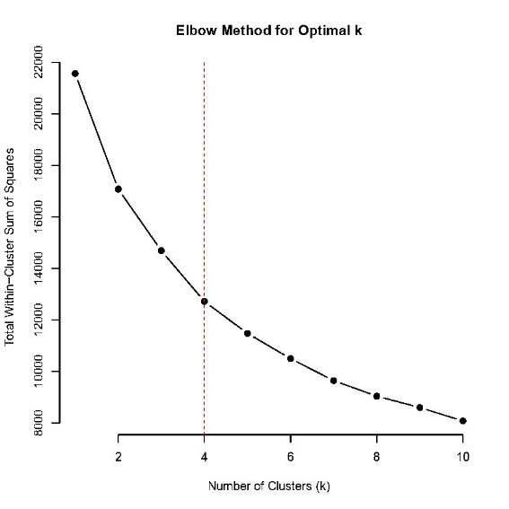
unsupervised machine learning methods(clustering)
Steps before clustering:
Data Scaling
finding optimal k
A)Elbow Method Interpretation
B)Silhouette Method Interpretation
Notes:
Before applying clustering algorithms, the data was scaled using the scale() function. This ensures that all features are on the same scale, preventing variables with larger ranges from dominating the clustering process
Both the Elbow Method and Silhouette Method point to k = 4 as the optimal number of clusters for this dataset. This means that the data can be meaningfully grouped into 4 distinct clusters, which provide both well-defined separation and optimal within-cluster variance

Slide 33
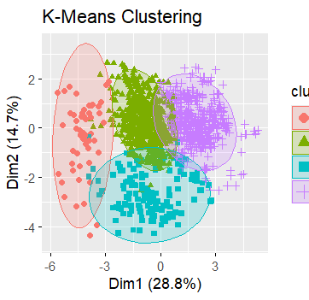
K-Means Clustering Analysis
plot shows the K-Means clustering with 4 clusters, visualized using the first two principal components. Each color and shape represent a different cluster, and the ellipses indicate the spread of the data points within each cluster

Slide 34
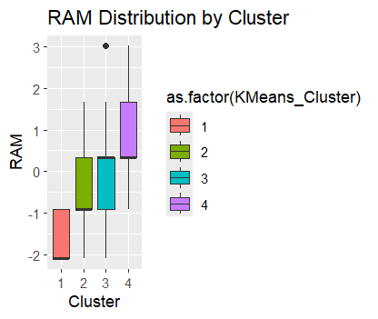
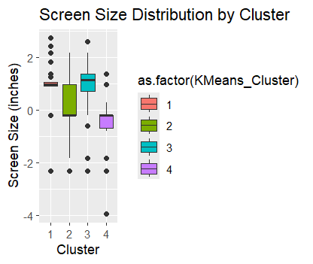
K-Means Clustering Analysis
RAM Distribution:
The RAM distribution across clusters shows that Cluster4 has significantly higher RAM compared to the other clusters, consistent with high-end laptops. Clusters 1 and 2 have lower RAM, with Cluster 1 having the least.
.
Screen Size Distribution:
Cluster 3 stands out with the largest screen sizes, while Clusters 1 and 2 have smaller screens.

Slide 35
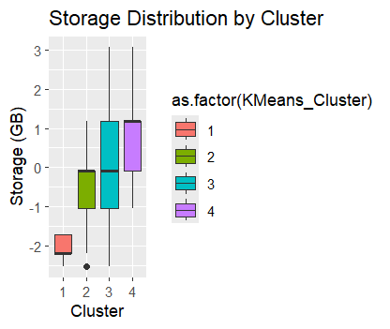
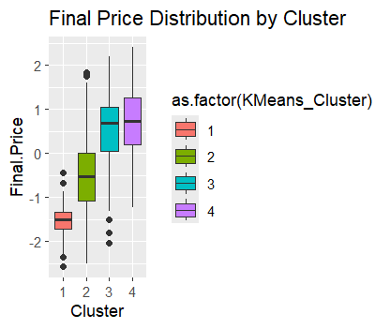
K-Means Clustering Analysis
Final Price Distribution
Storage Distribution
Notes:
Final Price Distribution:
▪ Final Price distribution reveals that Cluster 4 contains the most expensive laptops,
followed by Cluster 3. Cluster 1 includes the least expensive laptops, which aligns
with their lower specifications. The storage distribution across clusters shows that Cluster 3 has significantly
higher storage values compared to the other clusters, consistent with users who
require more storage capacity. Cluster 4 also exhibits relatively high storage,
though with slightly less variation than Cluster 3. In contrast, Clusters 1 and 2
have lower storage capacities, with Cluster 1 having the smallest storage values. Cluster 1:
▪ This cluster is characterized by lower RAM, Storage, and Final Price. It seems to
consist of lower-end laptops with less powerful configurations.
o Cluster 2:
▪ This cluster has moderate values for most features. The laptops in this cluster
likely have mid-range configurations, making them suitable for average users.
o Cluster 3:
▪ This cluster includes laptops with the highest average screen size and relatively
high storage, indicating larger, possibly gaming or workstation laptops.
o Cluster 4:
▪ This cluster has the highest average RAM and Final Price, suggesting that it
contains high-end laptops, possibly used for gaming, content creation, or other
resource-intensive tasks.

Slide 36
Cluster Descriptions:
Cluster 1:
▪ This cluster is characterized by lower RAM, Storage, and Final Price. It seems to
consist of lower-end laptops with less powerful configurations.
o Cluster 2:
▪ This cluster has moderate values for most features. The laptops in this cluster
likely have mid-range configurations, making them suitable for average users.
o Cluster 3:
▪ This cluster includes laptops with the highest average screen size and relatively
high storage, indicating larger, possibly gaming or workstation laptops.
o Cluster 4:
▪ This cluster has the highest average RAM and Final Price, suggesting that it
contains high-end laptops

Slide 37
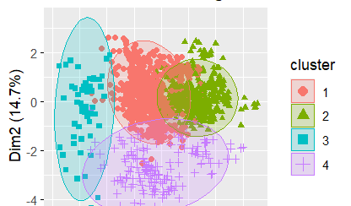
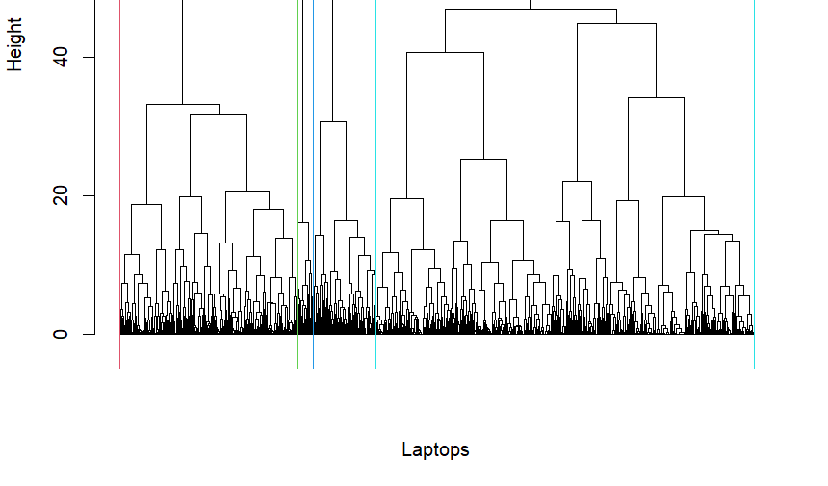
Hierarchical Clustering Analysis
Hierarchical Clustering Dendrogram
Cluster 1: Basic Configurations & Lower Prices
Cluster 2: Mid-Range to High-End Laptops
Cluster 3: Entry-Level Budget Laptops
Cluster 4: Premium Laptops with High Performance
Notes:
The dendrogram shows the hierarchical clustering process, where each merge is represented by a horizontal line. The height of the merge indicates the dissimilarity between the clusters being merged. The lower the height, the more similar the clusters. The dendrogram suggests a natural division into 4 clusters, consistent with the K-Means analysis.

Slide 38
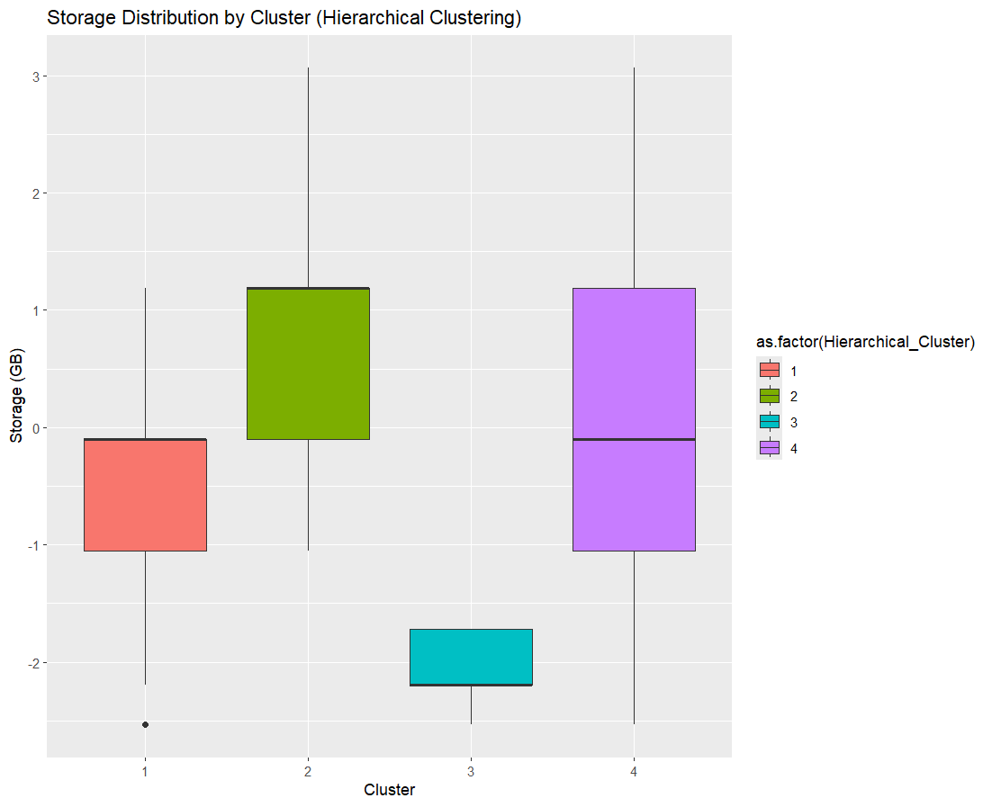
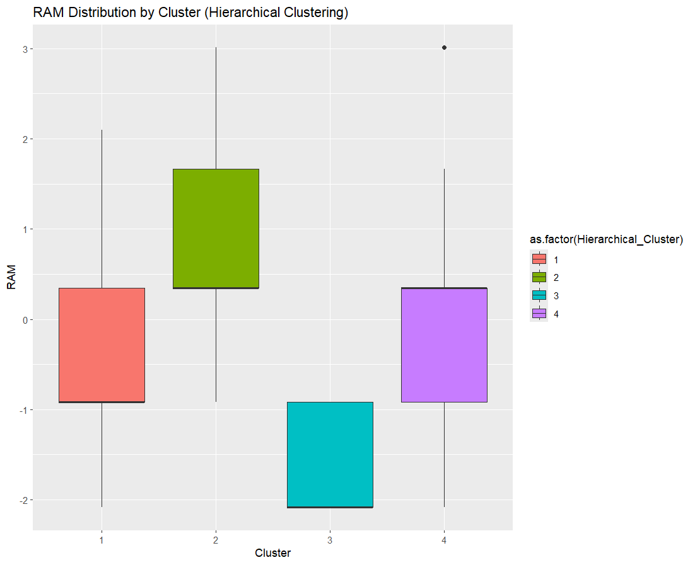
Hierarchical Clustering Analysis
RAM Distribution:
The RAM distribution across clusters shows that Cluster 2 has the highest RAM, indicating devices with more powerful memory capacities. Cluster 4 also has higher RAM, but not as much as Cluster 2. Clusters 1 and 3 have lower RAM, with Cluster 3 having the least, possibly representing lower-end devices.
Storage Distribution:
The storage distribution shows that Cluster 4 has the highest storage capacity, with a wide range of storage values, indicative of more robust storage devices. Cluster 2 follows with moderately high storage values. Cluster 3 shows the lowest storage distribution, while Cluster 1 also has lower storage compared to Clusters 2 and 4.
Notes:
Cluster 1:
This cluster is characterized by lower RAM, moderate screen sizes, and lower final prices. It appears to represent lower-end laptops with basic configurations. Storage is relatively low, indicating less storage capacity.
Cluster 2:
Cluster 2 is marked by high RAM and storage, along with moderate screen sizes. The final prices for this cluster are moderate to high, suggesting that this group consists of mid-range to high-end laptops that balance both storage capacity and performance.
Cluster 3:
This cluster is defined by the lowest RAM, storage, and screen sizes among all clusters. Final prices are also relatively low. It likely represents budget or entry-level laptops, with minimal specifications aimed at cost-conscious users.
Cluster 4:
Cluster 4 stands out with high RAM, storage, and larger screen sizes. The final prices in this group are also the highest, making it indicative of premium laptops. This cluster includes devices with robust performance and significant storage, suitable for users requiring higher-end computing capabilities.

Slide 39
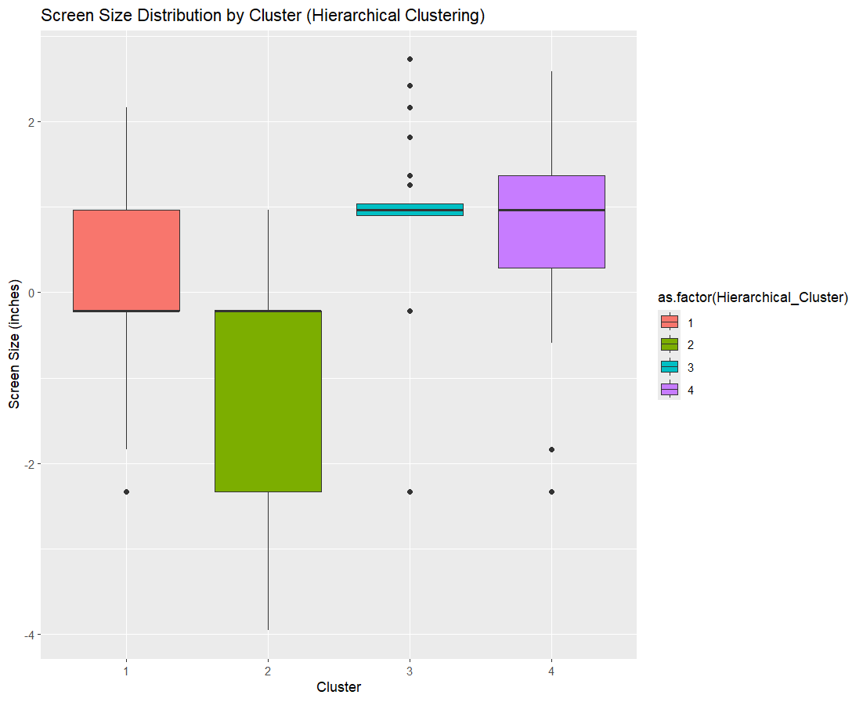
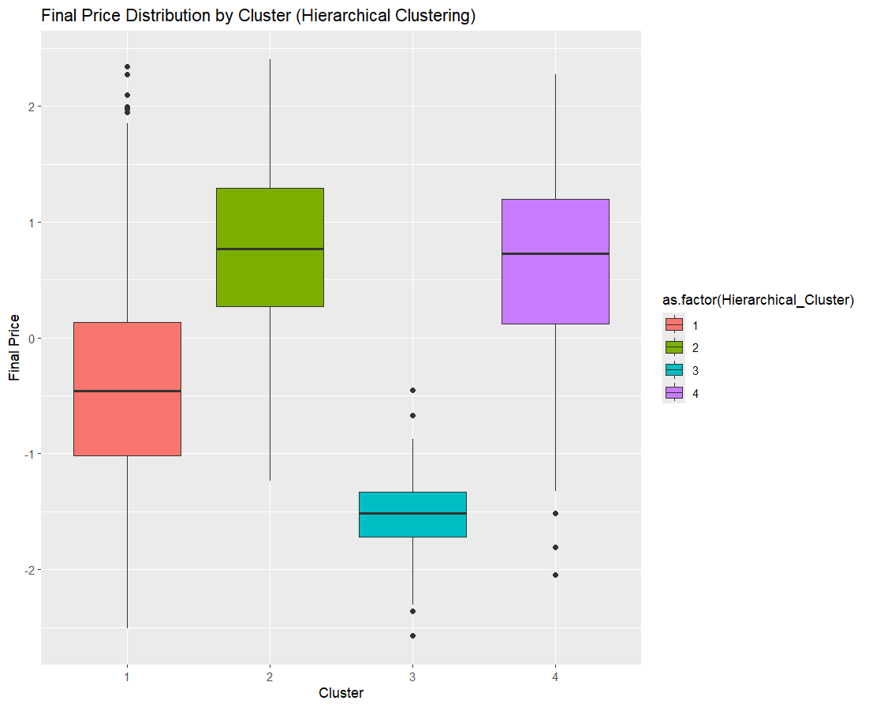
Hierarchical Clustering Analysis
Screen Size Distribution:
The screen size distribution across clusters indicates that Cluster 4 has the largest screens, with a relatively narrow range, suggesting larger, more uniform screen sizes. Cluster 1 also has relatively large screen sizes, while Cluster 2 has a moderate spread. Cluster 3 has the smallest screen sizes.
Final Price Distribution:
The final price distribution indicates that Cluster 4 has the highest prices, aligning with its higher RAM, storage, and screen sizes. Cluster 2 also shows higher prices, though slightly lower than Cluster 4.
Clusters 1 and 3 have lower price ranges, with Cluster 1 having the lowest prices, consistent with lower- end devices in terms of RAM and storage.

Slide 40
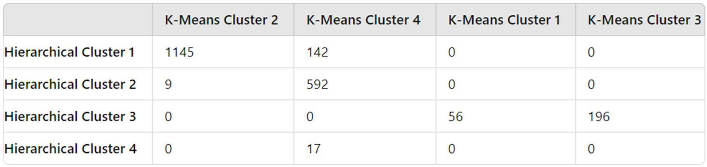
Number of Laptops in Each Hierarchical Cluster
Hierarchical Cluster 1:
1145 laptops from K-Means Cluster 2
142 laptops from K-Means Cluster 4
Total: 1287 laptops
Hierarchical Cluster 2:
9 laptops from K-Means Cluster 2
592 laptops from K-Means Cluster 4
Total: 601 laptops
Hierarchical Cluster 3:
56 laptops from K-Means Cluster 1
196 laptops from K-Means Cluster 3
Total: 252 laptops
Hierarchical Cluster 4:
17 laptops from K-Means Cluster 4
Total: 17 laptops.

Slide 41
Comparison with K-Means Clustering:
The contingency table compares the clusters formed by K-Means and Hierarchical Clustering. The results show that there is a significant overlap between the clusters identified by both methods. However, there are some differences:
Cluster 2 in K-Means has some overlap with multiple clusters in hierarchical clustering.
Cluster 4 in K-Means corresponds mainly to a single cluster in hierarchical clustering, indicating a strong agreement between the methods for high-end laptops.

Slide 42
Conclusion
The clustering analysis revealed four distinct groups of laptops based on key features like RAM, storage, screen size, CPU type, and price. The K-Means and Hierarchical Clustering methods largely agreed on the cluster assignments, with some variations.
Cluster 1 is similar in both algorithms, representing low-end devices, though hierarchical clustering shows a bit more variation in storage and RAM.
Cluster 2 is where the biggest difference appears. In hierarchical clustering, it has the highest RAM, making it more like mid-to-high-end devices, while in K-Means, it's more mid-range.
Cluster 3 remains the lowest in RAM, storage, and price in hierarchical clustering ,however in k means it includes laptops with the highest average screen size and relatively high storage and price.
Cluster 4 consistently represents the premium group with high RAM, storage, screen size, and price in both algorithms, though hierarchical clustering shows slightly more variation within the group.

Slide 43
THANKS FOR YOUR ATTENTION

